Slide 1
Making the Transition from WebForms to MVC
Mitchel Sellers
IowaComputerGurus, Inc.
msellers@iowacomputergurus.com @mitchelsellers

Slide 2
Please support our valuable sponsors

Slide 3
About Your Speaker
Mitchel Sellers
CEO of IowaComputerGurus, Inc.
Microsoft MVP, DNN MVP, ASPInsider
Contact Information
Blog: www.mitchelsellers.com
Email: msellers@iowacomputergurus.com
Twitter: @mitchelsellers

Slide 4
About this Session
Webforms & You!
History & Future?
What is MVC?
MVC, SPA, Hybrid, etc….
Example WebForms Module
MVC in DNN
Special Elements, etc
Example MVC Conversion
Parting Notes
Gotcha’s
Limitations?

Slide 5
WebForms and You
Status of Web Forms
Still a first class citizen in the DNN world
Not an “urgent” have to move situation
Designed around “easy forms”
Takes the stateless nature of the web and hides it from users
ViewState for state management
Complications exist with modern web
Bootstrap
Client-Side Interactions
Separation of Code & UI stuff

Slide 6
What is MVC? Part 1
Basic Concept
Separation of concerns is a priority
Model
Data Layer Classes
Think “User”, “Tab” or “TabModule”
Controller
Organizer of actions
Think “Things to be done”
List Users
Add User
Update User
Get Role List
View
Presentation
Think HTML/CSS

Slide 7
MVC, SPA, Hybrid, and More?
So, you get it, examples are great, but what gives with options?
SPA (Single Page Applications)
Common term thrown around to discuss implementations of complex solutions with a single root page. (Think Gmail)
Hybrid
Just another term, not to worry
Client Side Libraries, what and why?
Angular
Knockout
React
_____ super special framework

Slide 8
Example WebForms Module (.aspx) – Snipped for Brevity

Slide 9
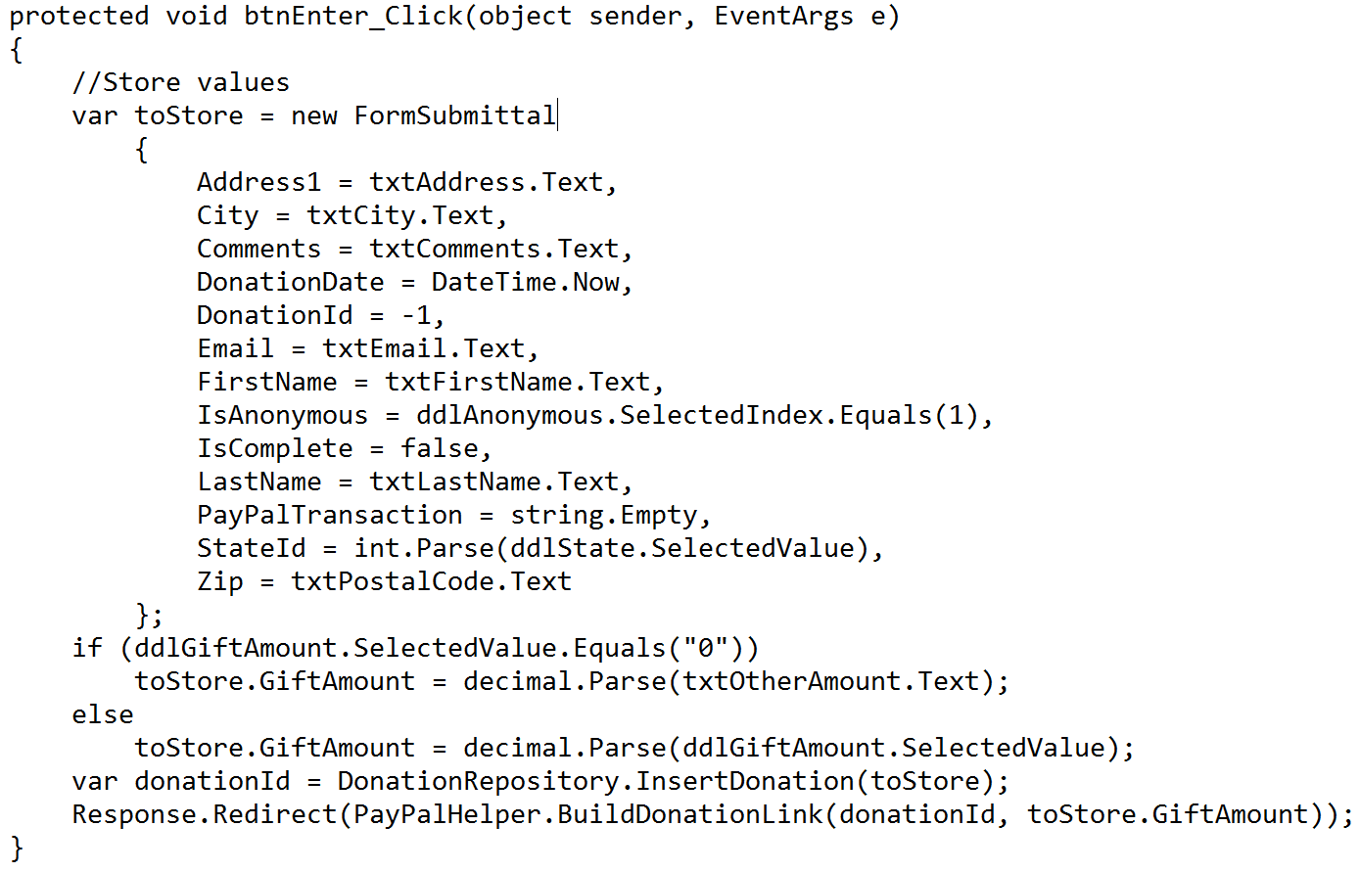
Example WebForms Module (.aspx.cs)

Slide 10
Getting Started with MVC In DNN vs Normal MVC
Project templates available
However, existing templates can be updated if needed
Must reference new NuGet package
DotNetNuke.Web.Mvc
Project will now have a “Route Mapper” to link to a controller
Special consideration over what is standard MVC

Slide 11
MVC DNN Setup Step 1: Route Mapper

Slide 12
MVC DNN Setup Step 2: Model Class

Slide 13
MVC DNN Setup Step 3: Controller

Slide 14
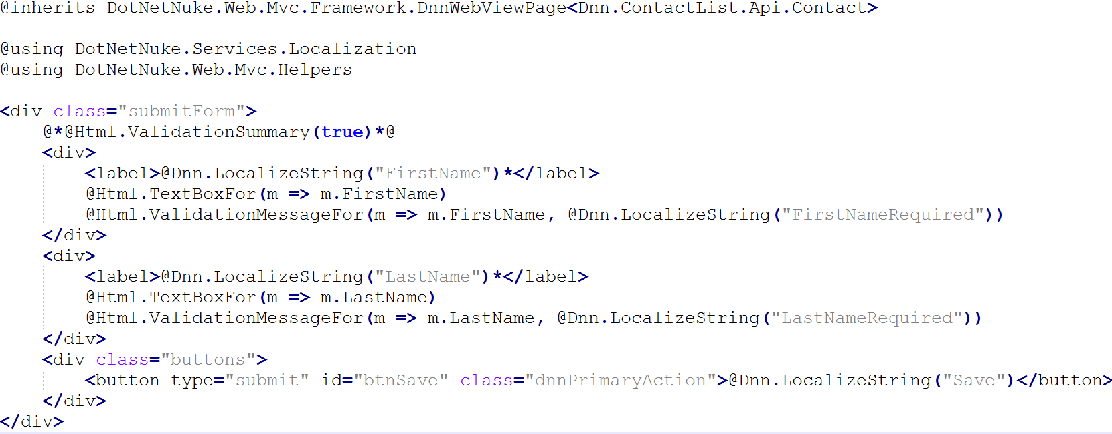
MVC DNN Setup Step 4: View – Snipped for brevity
Placed in /Views/Contact folder

Slide 15
MVC DNN Setup Step 5: Manifest Differences (Resources)

Slide 16
MVC DNN Setup Step 6: Manifest Differences (Module)

Slide 17
Summary of DNN Highlights
Module Files Must be installed to a /MVC folder, even though the module definition doesn’t look like it
Use full namespace/controller/action when referencing actions
Other methods can be added to the controller to be called via AJAX

Slide 18
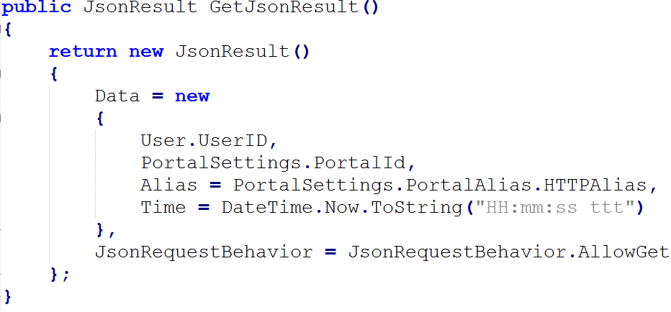
Advanced DNN MVC: Ajax Calls

Slide 19
Known Limitations/Issues with DNN & MVC
Until a few releases are made using the “Develop” menu item on a module will result in an error
Currently no solution exists for a RichTextEditor using the standard DNN editor

Slide 20
Helpful Resources
Microsoft WebForms => Web API https://msdn.microsoft.com/en-us/magazine/jj991978.aspx
DNN Sample Modules => https://github.com/dnnsoftware/Dnn.Platform.Samples.Mvc

Slide 21
Thank you

